Slide 1

Telework, Co-working, and Relocation:
How Will Economic and Technological Changes Alter Work Trips
TRB Planning Applications Conference
June 4, 2019

Slide 2

Background
Funding in California is tied to accurate measurement of GHG emissions
Unique factors in the SCAG region
Notes:
Funding in California is tied to accurate measurement of GHG emissions. A big piece of emissions is work-related travel (longer average distance etc).
A lot of studies on telecommuting but not many recent ones, especially ones based on localized data in the SCAG region.
Factors unique to SCAG:
Long commute trips , most congested region nationwide
Higher-income jobs/industries, multiple activity centers
SCAG has been looking at teleworking for a long time.
Telecommuting/work from home is input to SCAG’s ABM and off-model GHG reduction strategy evaluation
What SCAG has done in the past: 2016 ACS: ~ 5-6% of workers Then use past trends to project future shares

Slide 3
The Past and the Future
Source: ACS data
Notes:
We usually assume – ok, what happened in the past will continue into the future.
This what we did for SCAG for the future year baseline scenario, or “business as usual.”
What happens if it’s not “business as usual.”

Slide 4

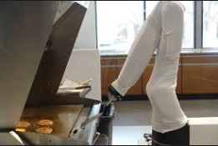


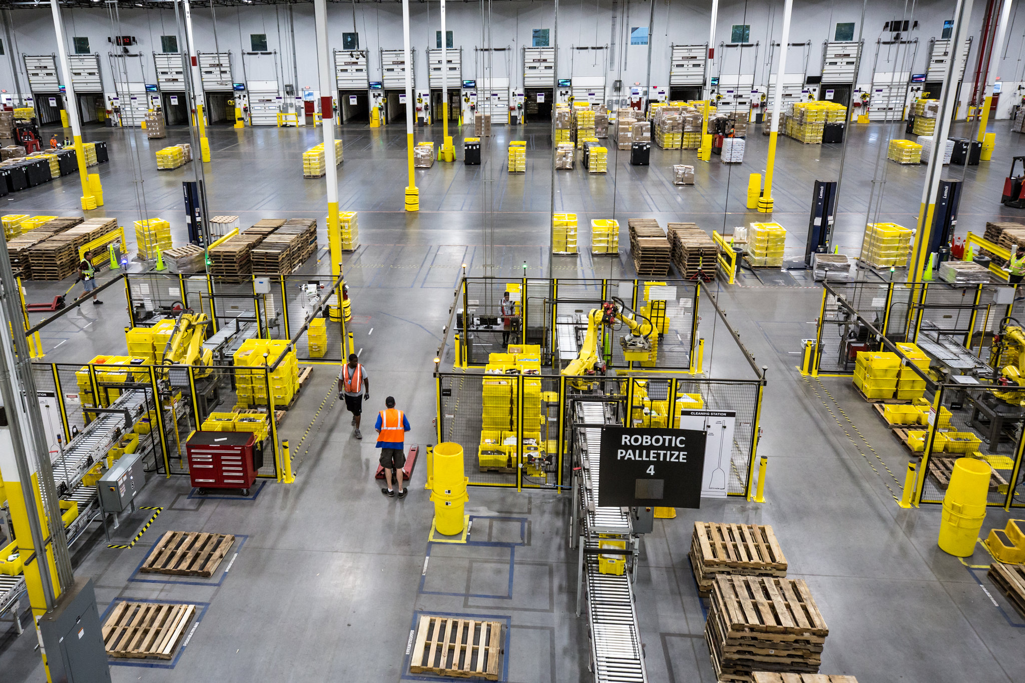


New Elements
Notes:
New elements
coworking spaces – claim to bring workplaces closer to people, more sustainable commuting patterns
gig economy – app-based job opportunities, connecting people to jobs that are side gigs or freelancing
technology – automation of job tasks
Two parts to this project:
A more rigorous analysis on those working from home, practical application for modeling and RTP
Exploratory research on how long-term structural changes in the nature of work might affect commuting
Picture credits:
Amazon pic: https://www.nytimes.com/2017/09/10/technology/amazon-robots-workers.html

Slide 5




Data
Existing Data
New Data
Coworking Site Survey
(273 samples)
Teleworkers
(1000 samples)

Slide 6
Teleworkers
Notes:
Using multiple datasets to quantify number of teleworkers and their characteristics. Need clear definition to compare across data sources.
Telecommuter definition: workers with a regular workplace location but worked from home at least one day a week.
Home worker definition: workers with primary workplace location at home and work there full-time Monday – Friday
Telecommuters tend to be higher income. Home workers have low and high incomes (about 50% in home-based businesses). WFH Equivalents all 1.5-1.9%
Telecommute baseline estimates and trend analysis complicated by slightly different definitions.
Home workers. Estimates range from 5% to 15% depending on survey. ACS remains the best source. Roughly 6%.
Now that we know about teleworkers, we wanted to see how these work arrangements impacted their VMT…..
Telecommuter definitions:
CHTS: User-defined as 1) A worker with a fixed workplace location, has one job and works 30+ hours a week, but goes to that fixed workplace less than 5 days a week or 2) A worker has two jobs, both with fixed workplace location, and go to either location fewer than 5 days a week
NHTS 2009: If a person have the option of working at home and at least worked from home 1 day per week
NHTS 2017: Partial teleworker were defined as non-home-workers who has a teleworking option and at least teleworked 1 day per week
Home worker definitions:
ACS: Those who reported working from home as their commute last week.
CHTS: User-defined as 1)those who reported their primary work location as "Home", worked at home 5 days a week, reported working from "Monday through Friday", worked more than 30 hours a week; or 2) those with two or more jobs and the primary locations of both jobs are at home.
NHTS 2017: Those who reported worked from home full-time or part-time

Slide 7
VMT Impacts
Notes:
Used CHTS and NHTS to look at VMT and the rebound effect. If they work from home, how much “other” travel are they doing instead.
From Lit Review: mixed bag, but most studies report about a 10-25% rebound for non-commute travel
What we found were similar patterns across both datasets.

Slide 8
VMT Impacts
1/3 to 1/2 are still making “work” trips
Notes:
Workers who work from home:
1/3 to 1/2 are still making “work trips”
Work trips tend to be longer than those with commutes to a fixed workplace location.

Slide 9
VMT Impacts
More travel on days they do go to work

Slide 10
VMT Impacts
Telecommuters produce about the same VMT overall…
Notes:
Workers who work from home:
1/3 to 1/2 are still making “work trips”
Work trips tend to be longer than those with commutes to a fixed workplace location.
From Lit Review: mixed bag, but most studies report about a 10-25% rebound for non-commute travel
Telecommuters did more non-work driving on telecommuting days (Kimberly 2001).
“Rebound Effect” of about 25 % from reduced work travel (Mokhtarian, 1991).
Teleworkers have more VMT for both daily work and non-work trips compare to non-telecommuters - travels additional 38 vehicle miles daily (Zhu 2014).
Didn’t travel for work: 6-10 miles of non-work trips.
Did do other work-related travel: 36-45 miles.
Regular fixed commutes are 25-30 miles…
WFH ACS increased from just above 4 to nearly 6% since 2006…

Slide 11
VMT Impacts
…but not on the days they telecommute or work exclusively from home.
Notes:
With a good estimate of how things are now, we look to how things might change in the future.

Slide 12
Coworking Site Survey

Slide 13
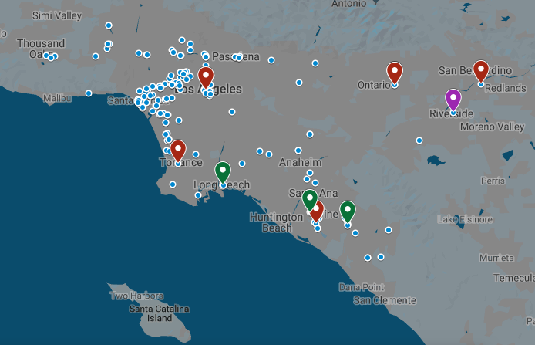
Coworking Spaces
4% of Americans have worked in a coworking site.
Notes:
Increasingly popular, flexible model of short-term, shared office space.
In-person survey: 10 locations, 273 respondents
Learned about the types of people that work in coworking – tend to be younger (36% are millennials), work full-time, more likely to work in IT and consulting
Freelancers (12%) and entrepreneurs likely to have multiple jobs
More than twice as likely to work multiple jobs than the overall region average.
But…Could these spaces reduce VMT?
According to the Pew Research Center, 4% of Americans have worked in a coworking site.
https://www.pewinternet.org/2016/05/19/other-shared-and-on-demand-services
While shared workspaces have grown at incredible rates (200%) over the past five years, this may be more reflective of the supply rather than the demand for such spaces. Emergent Research has forecasted a 14.7% average annual growth rate in the number of coworking site members between 2018 to 2022.

Slide 14

Why Work at a Coworking Site?
Notes:
40% people choose to work at coworking sites because it is closer to home and less travel
Others prefer coworking sites for increased amenities, social interaction, and fewer distractions. These workers are often self-employed.
A study of coworking sites in the Netherlands revealed that 64% of survey respondents reported looking for a workplace outside of their home as one of their top 3 motivations for working at a coworking space. The 2017 Global Coworking Survey showed that about half (45%) of coworking members worked from home before switching to a coworking space.
Weijs-Perree et al (2018). Analysing user preferences for co-working space characteristics. Building Research and Information.

Slide 15
What’s the Alternative?
Notes:
Without coworking sites, where will these people go?
57% choose home as alternative working site, 32% report that they will work at other company office – this is similar to what we saw in the lit review.
Some people choose to work at a coworking site instead of working at home full-time (fewer distractions at an office, social interaction), which would increase VMT. On the other hand there’s 32% saying that’d commute to another office (presumably much further away, otherwise they’d probably just work there).
Coworkers whose would be working in a distance company office if a coworking site was unavailable – for whom the presence of a coworking site decreases their work travel. These coworkers prefer coworking sites primarily to reduce their commute and report using the extra time saved from commute on productive work time or with engaging in activities with family, community, or personal time.

Slide 16
Coworker Travel Behavior
Notes:
45% work for employee with a larger SoCal office
This graphic is for those whose alternative would be to work from another company office.
Most sites people live closer to coworking sites than their SoCal offices, except LA and San Bernardino.
They work there for reasons other than saving on commute time/costs. 70% people choose to work at Regus DTLA for non-commute related reasons.
NOTE THAT THE NUMBERS PRESENTED ON THIS SLIDE IS A VERY SMALL SAMPLE SIZE (29)

Slide 17
The Future of Work

Slide 18

Gig Economy
Notes:
We looked at what are the characteristics of gig workers, how many are there and is it increasing?
No commonly accepted definition: but Long-standing characteristics:
Contingent/freelance workers
Self-employed
Multiple jobholders
Today – there are representing on-demand and sharing economies, multiple jobs
Estimates of participation range from 10-35%
New element: “Electronically-mediated employment”
Available data estimates 1-8% participation
Top 3 occupation categories
Professional, transportation, service
Data challenges:
May not even be considered a “secondary job” by some
Sporadic/informal/unreported
Freelancing expected to grow from 34% in 2018 to 40% in 2020 (Dubey 2018)

Slide 19
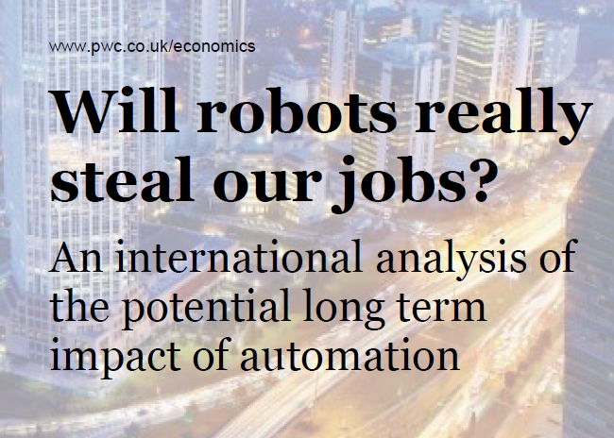

Automation Potential
Differences by industry and occupation
  Healthcare, social assistance, education
  High skill, creativity, social intelligence
  Administrative, manufacturing,
  driving tasks
Growth
Decline
Notes:
The estimates of the total fraction of jobs in the U.S. at risk of automation varies widely – from as low as 9 percent to as high as 47 percent.
The variations relate largely to what assumptions are made about the extent to which a particular occupation’s individual tasks can be automated before the overall job is automated.
Even beyond total job automation, it is likely that many occupations will see changes to skill requirements if the tasks can be partially automated.
Most studies only quantified potential displacement by automation, but most also acknowledged that there would be offsetting job gains due to wealth and productivity effects.

Slide 20
Automation Potential
Notes:
For how these changes might impact the SCAG region, we looked at total employment by occupation.

Slide 21
Automation Potential
Notes:
And multiplied those jobs by the likelihood of that occupation being automated – here are results from two studies have show similar trends
High potential of automation/job loss in farming/production
Lower risk in education, healthcare, engineering, computer, legal, etc. – high skill, high income jobs.

Slide 22
Automation Potential
Notes:
Adding here another study to show the variation

Slide 23
How Does This Fit Together?
Drivers of Change
Economic Changes
Job Changes
Travel Changes
Technology
Automation
ICT
Job displacement
Trip Frequency & VMT by Location and Time of Day
Commute / work-related travel
Other travel
Change in jobs by industry and occupation
Job creation
Demand
Consumer preferences
Demographics
Work arrangement
Change in Commute
Teleworking
Work from home
Self-employment / Freelancing
Automation Potential
Gig Economy

Slide 24
Thank You
mbina@camsys.com

